Slide 1
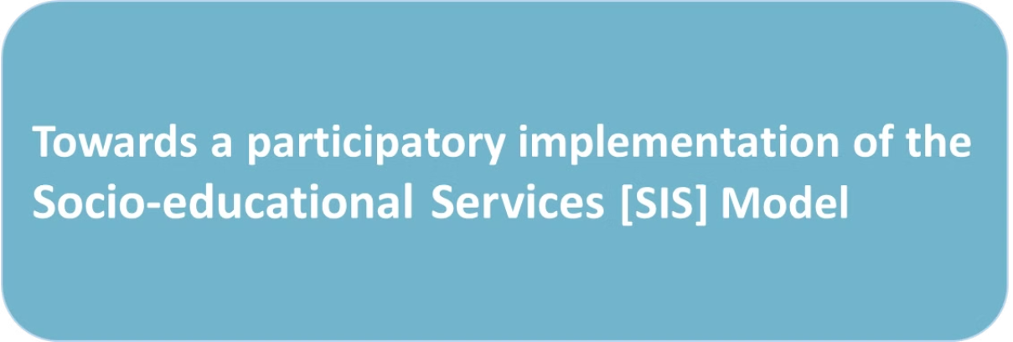

Maria Carmelita Lapadula
Head of Knowledge and Social Innovation
FEDAIA - Federation of Organisations for Child and Adolescent Care
Catalonia

Slide 2

Structure
1
How we see the new family support policies in Catalonia
2
What we think about the new model (SIS)
3
How should family and child rights organisations be involved
4
How the model is applied in Barcelona
5
What we do to strengthen families

Slide 3
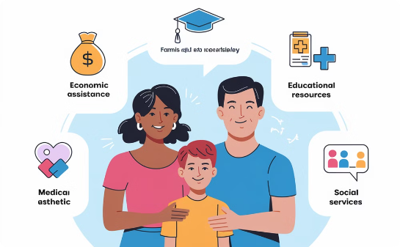
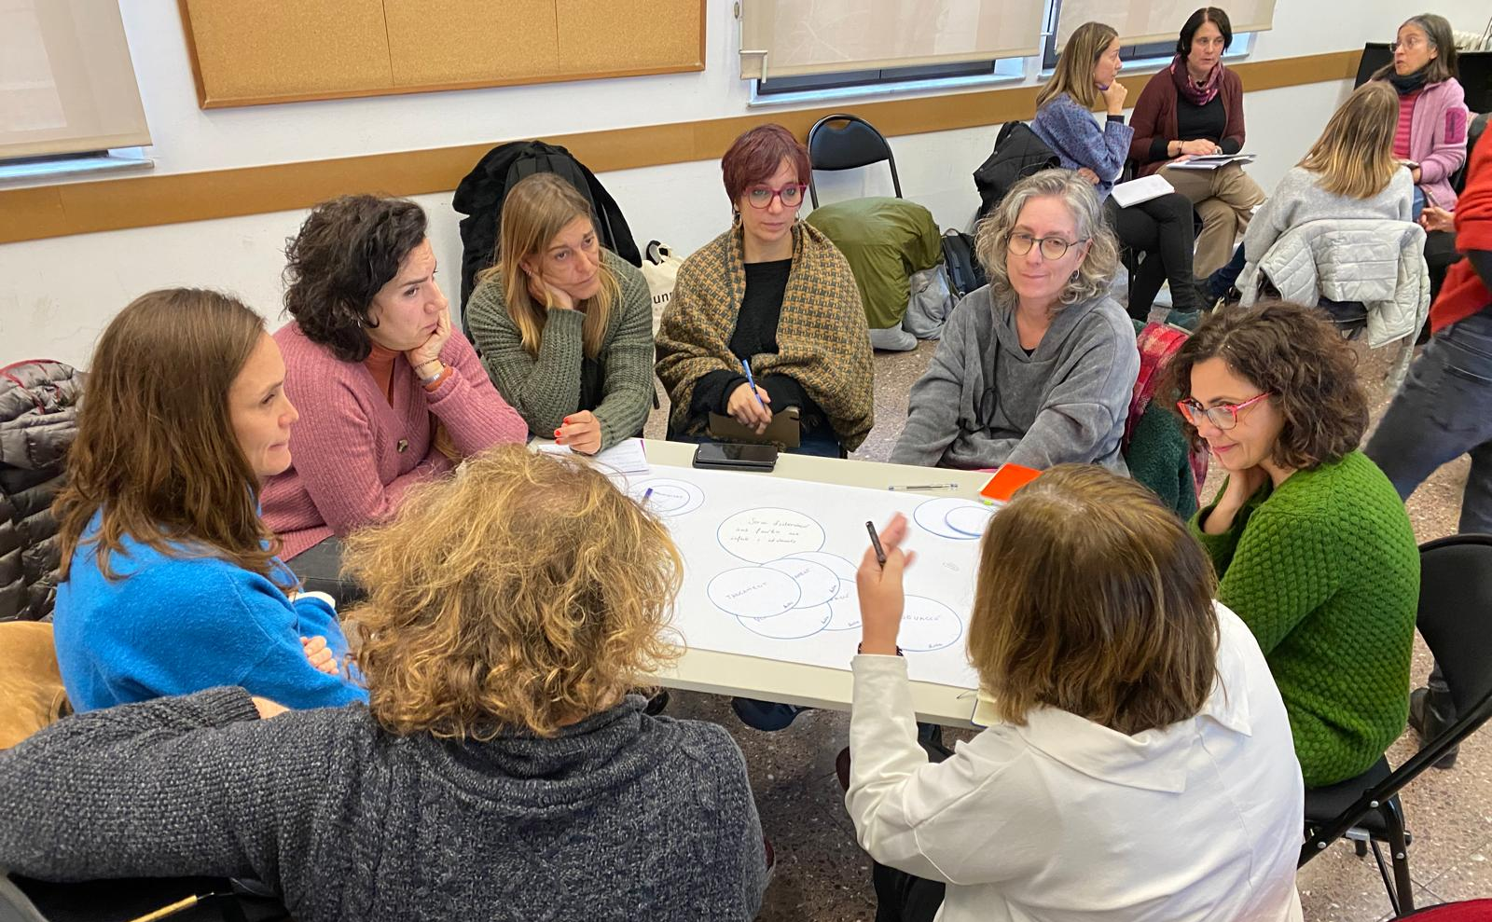
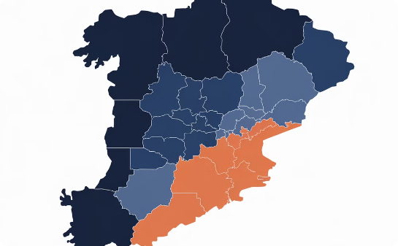
Family support policies in Catalonia
Fostering Strong Families
Integrated Policy Solutions
Consistent Implementation
There are numerous projects dedicated to preventing institutionalisation, neglect, and risk by offering comprehensive socio-educational services, parental competence development programmes, family care, and community-based residential centres.
We advocate for robust, integrated policies that address fundamental needs, including economic assistance, socio-educational support for children and families, and comprehensive care to ensure the protection of their rights.
While these policies exist, their implementation often lacks consistency and a clear understanding of their impact, creating a need for improved coordination and evaluation.

Slide 4




Considerations on the SIS Model
Reduces institutionalisation rates.
Emphasises prevention and holistic childcare.
Empowers families and enhances their capacity to care.
Inter-entity collaboration for comprehensive services.
*SIS = Non-residential socio-educational intervention services for children and adolescents

Slide 5
Areas for Improvement in the
SIS Model implementation
Model Legitimation
Expanded Preventive Interventions
Comprehensive Life-Cycle Approach
Strong legal frameworks and adequate funding.
Focus on mild and moderate risk cases.
Support from pregnancy to adulthood.
Equitable Implementation
Family Participation
Care for Professionals
Uniform application across territories.
Throughout the whole process, from policy-making to individual attention.
Reverse the chronic underfunding of the system and professionalise the sector.

Slide 6
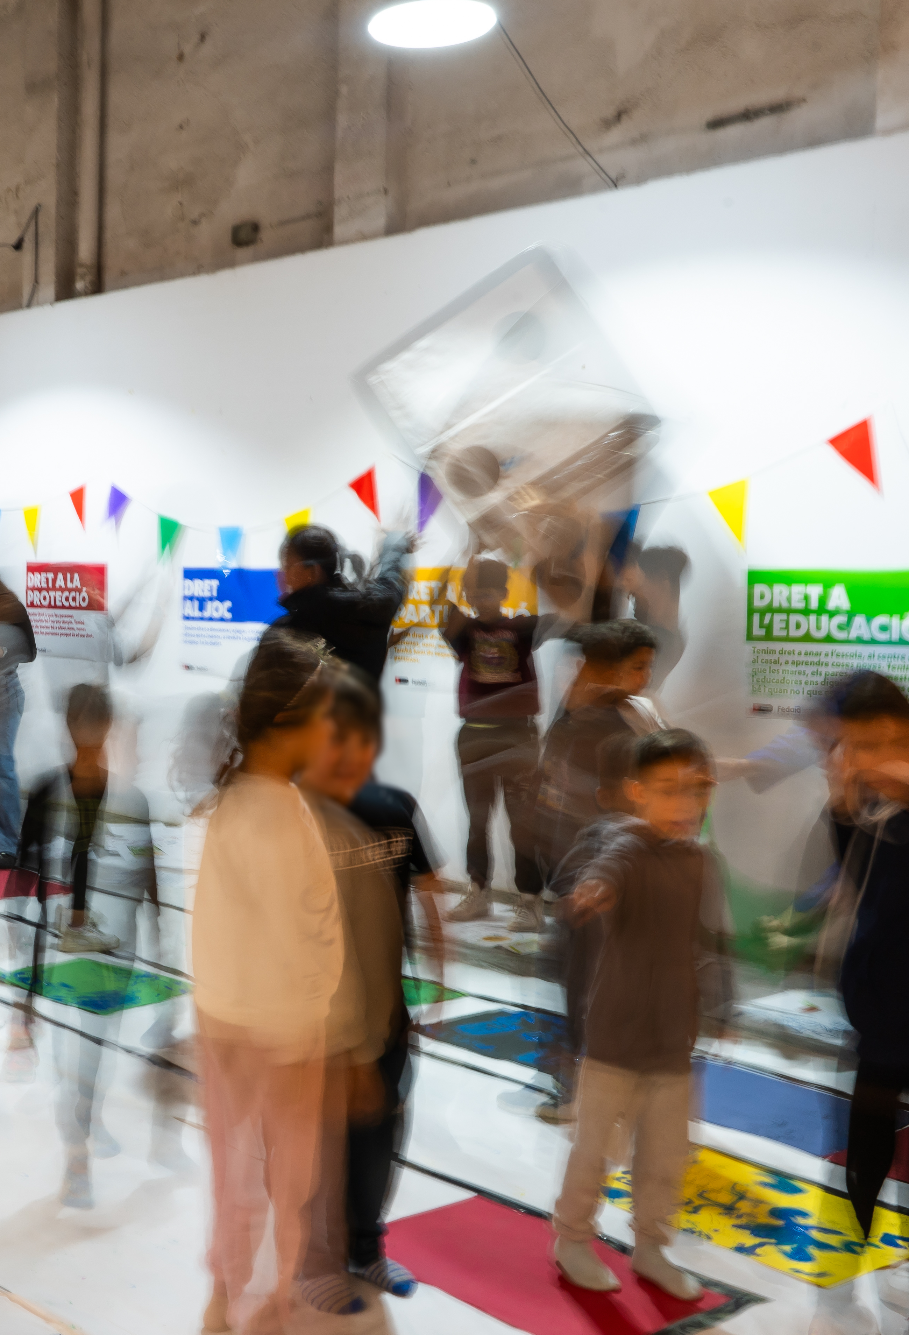




Approaches for an effective
Model Implementation
Evidence-Based
Participative
Research-backed strategies
Stakeholder engagement
Intersectional
Community-Focused
Integrated service delivery
Local resource leverage

Slide 7
The Model Implementation Design
at Barcelona
Reflective Process
Needs Assessment
Service Adaptation
Continuous Improvement
Collaborative reflection with professionals and users.
Comprehensive analysis of children's and families' needs.
Services focused on identified needs.
Ongoing evaluation and adjustment for relevance and effectiveness.

Slide 8



Strengthen Families to
Prevent Institutionalization
Child-centred approach
Prevention and inclusion
Collaborative network
Professional teams
Put the child's well-being at the heart of every decision we make.
Early intervention to prevent future problems and ensure that children's rights are granted.
Work closely with different organisations and administrations to provide comprehensive care.
Build and maintain skilled and dedicated teams to deliver high-quality services.

Slide 9

Thank You!
We appreciate your time and valuable insights.
We are committed to strengthening families and fostering a positive impact on children's lives.
Please feel free to reach out with any questions or further discussion.
Contact us at clapadula@fedaia.org

